Slide 1
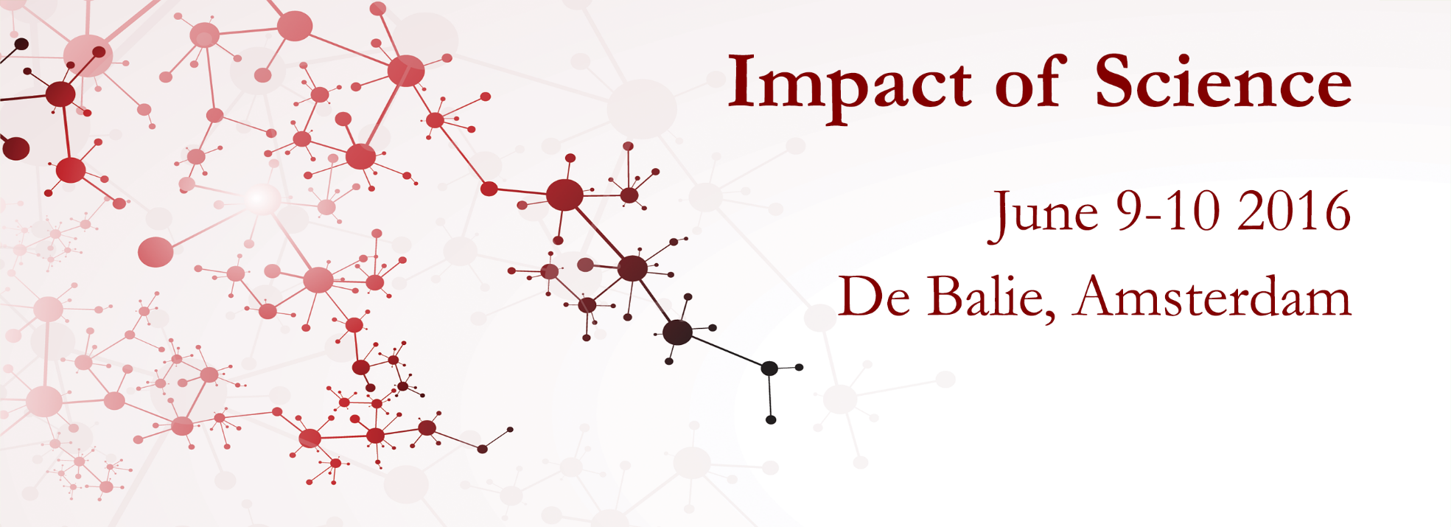
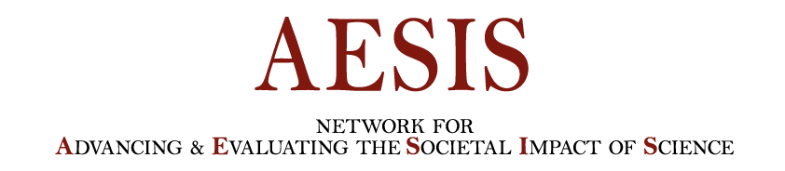
Impact of Science Conference the Parallel Session on:
Sustainable Cross-border Cooperation
25th June, 2021

Slide 2
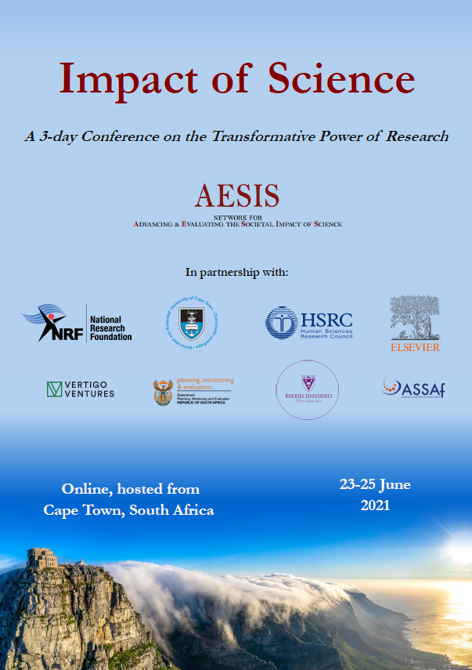

Impact of Science
23-25 June, 2021
Ben Ku (Chair): Associate Professor at the Hong Kong Polytechnic University, Hong Kong
Catherine Odora Hoppers: Professor Extraordinarius in Education, Univeristy of South Africa, Uganada
Sioux McKenna: Professor & Director of the Centre for Postgraduate Studies at Rhodes University, South Africa
Lesley Green: Director: Environmental Humanities South and Professor of Anthropology, University of Cape Town, South Africa
Overview of the Speakers
#IOS21

Slide 3
Impact of Science
23-25 June, 2021
Ben Ku
Associate Professor at the Hong Kong Polytechnic University, Hong Kong
#IOS21

Slide 4
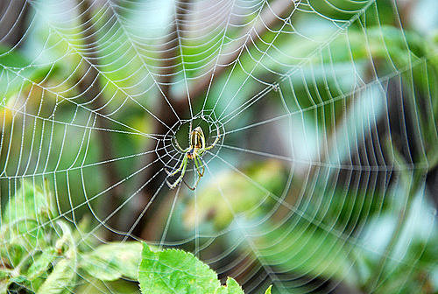
Envisioning Sustainable Cross-border Partnership : an Example of Social Work in Hong Kong
Dr. Benjamin Hok Bun KU
The Hong Kong Polytechnic University,
China Research and Development Network
Peking U-PolyU China Social Work Research Centre
Notes:
Today is the world social work day. It is quite meaningful to have the panel here. The theme of this year is Ubuntu which is resonates with social work perspective of the interconnectedness of all people and their environments.

Slide 5
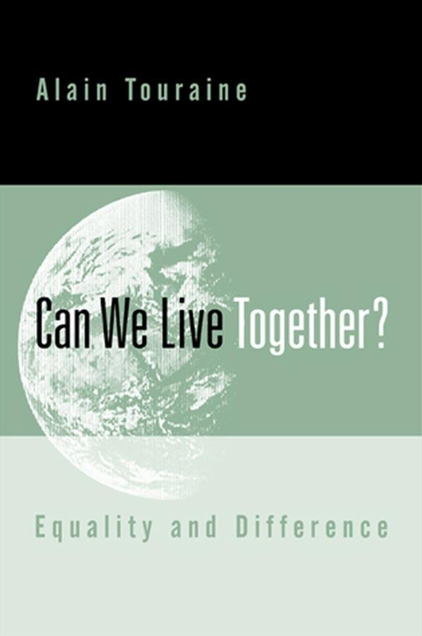
Can we live together?
In 2000, Alain Touraine published Can We Live Together: Equality and Difference.
He explores the question of how we might live together in a globalized world. To him, a global melting pot assumption actually has destroyed our dream of living together as equals, sharing the same social and cultural values. In contrast, globalization has erased our local identity, eroded cultural diversity, caused genocide…
War, conflict and disaster have become the common phenomena in the world.
How can social work rebuild our dream of living together? How can social work repair cracks of the world and reconciliate the broken relationship?

Slide 6
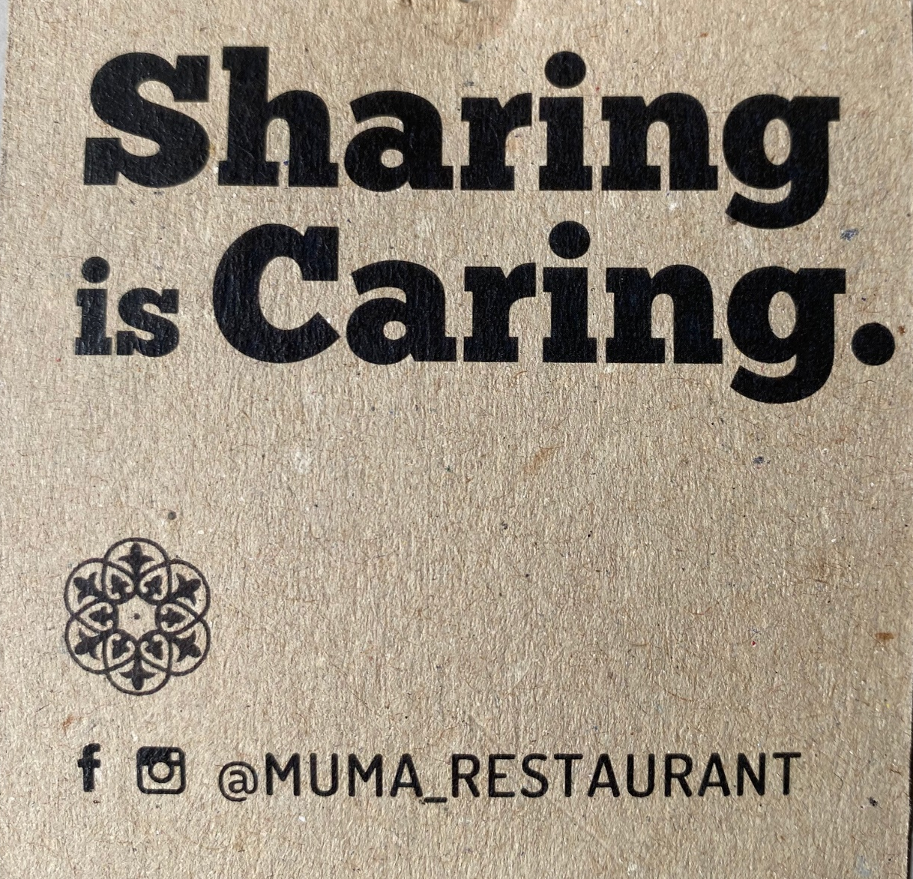
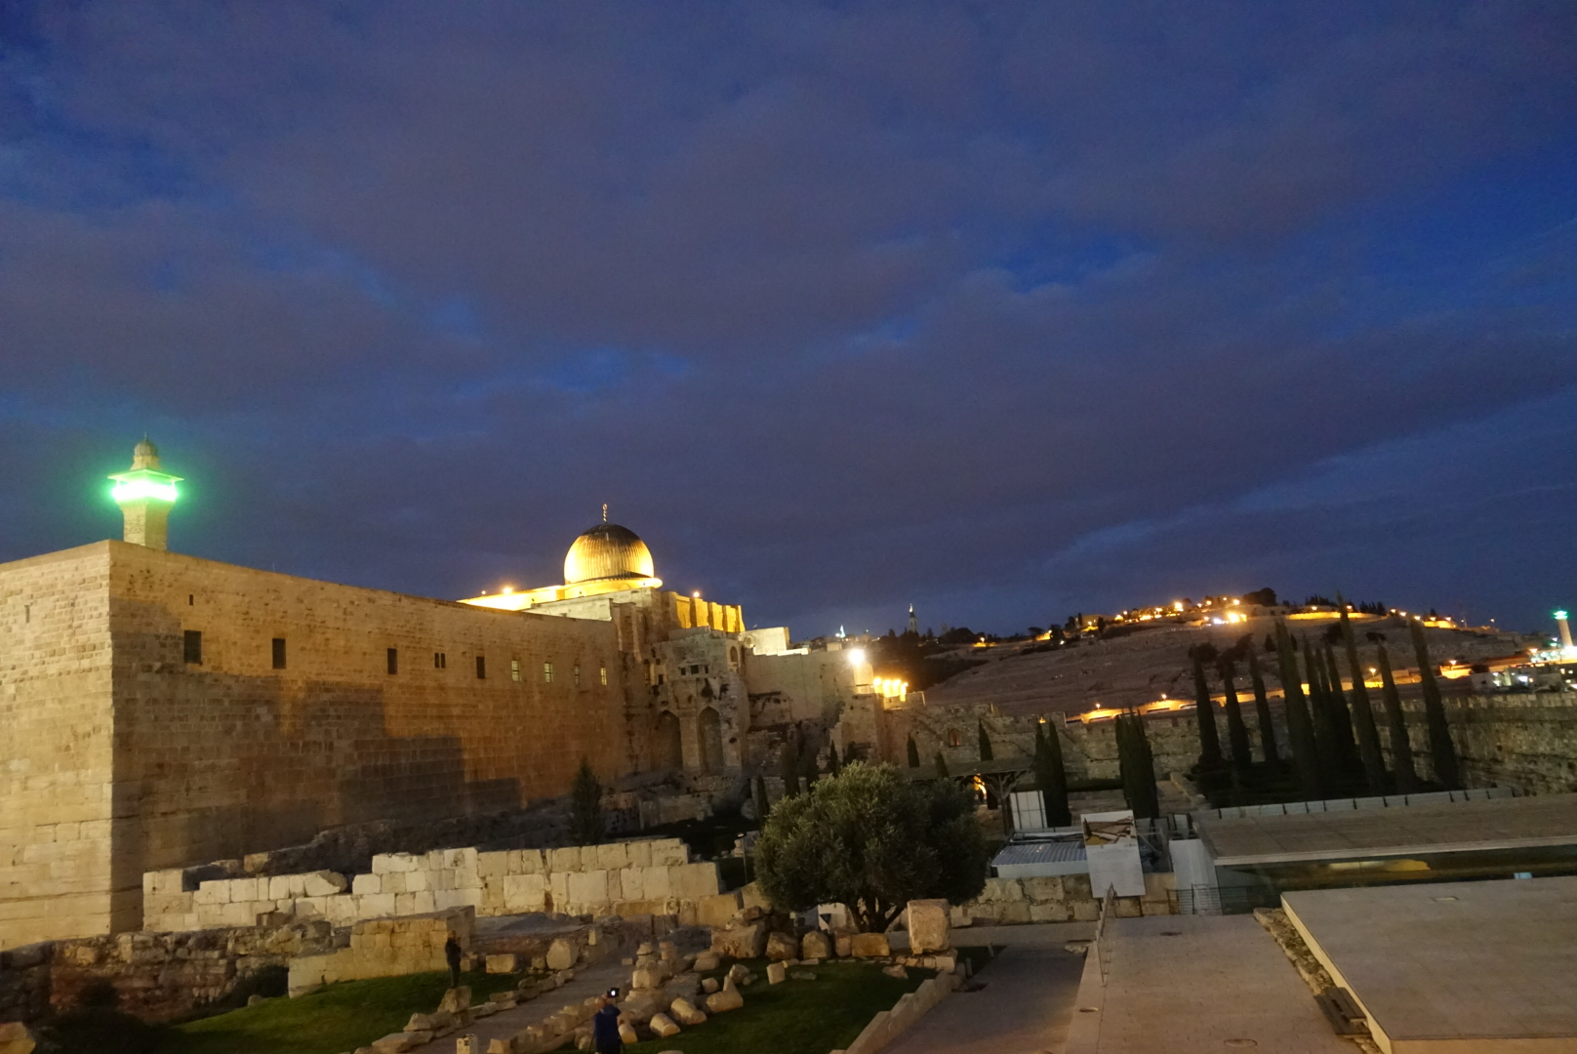
My Trip to Israel in 2018

Slide 7
New Challenges, New Opportunities?
Can be challenges, also opportunities
What is role of social work in cross-border partnership?
  Ethic of justice and ethic of caring embedded in social work profession
  Cultural diversity & inclusiveness as core social work values
  Social work professional knowledge & skills to foster harmony

Slide 8

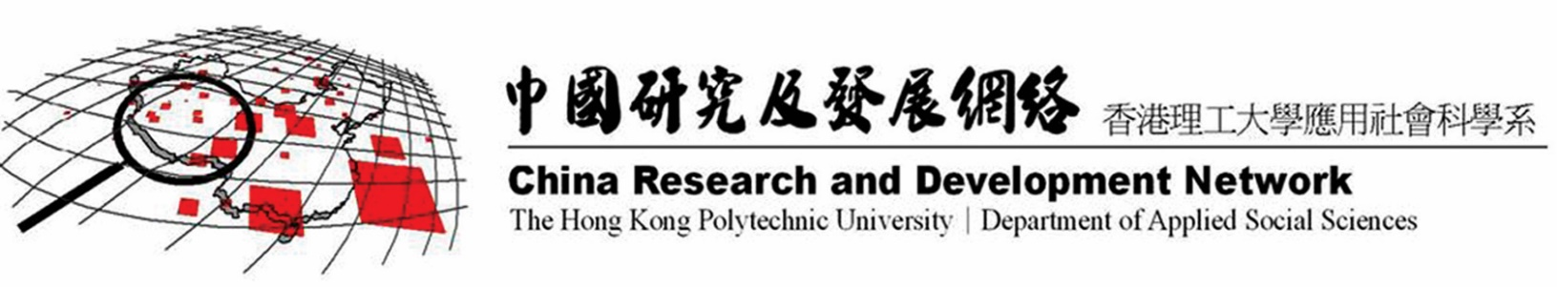
Small, but Significant!
Hong Kong as world city, as bridge, as network maker…
Hong Kong is one of the pioneers in the professional development of social work in Asia
China Research and (Global) Development Network at the Hong Kong Polytechnic University

Slide 9
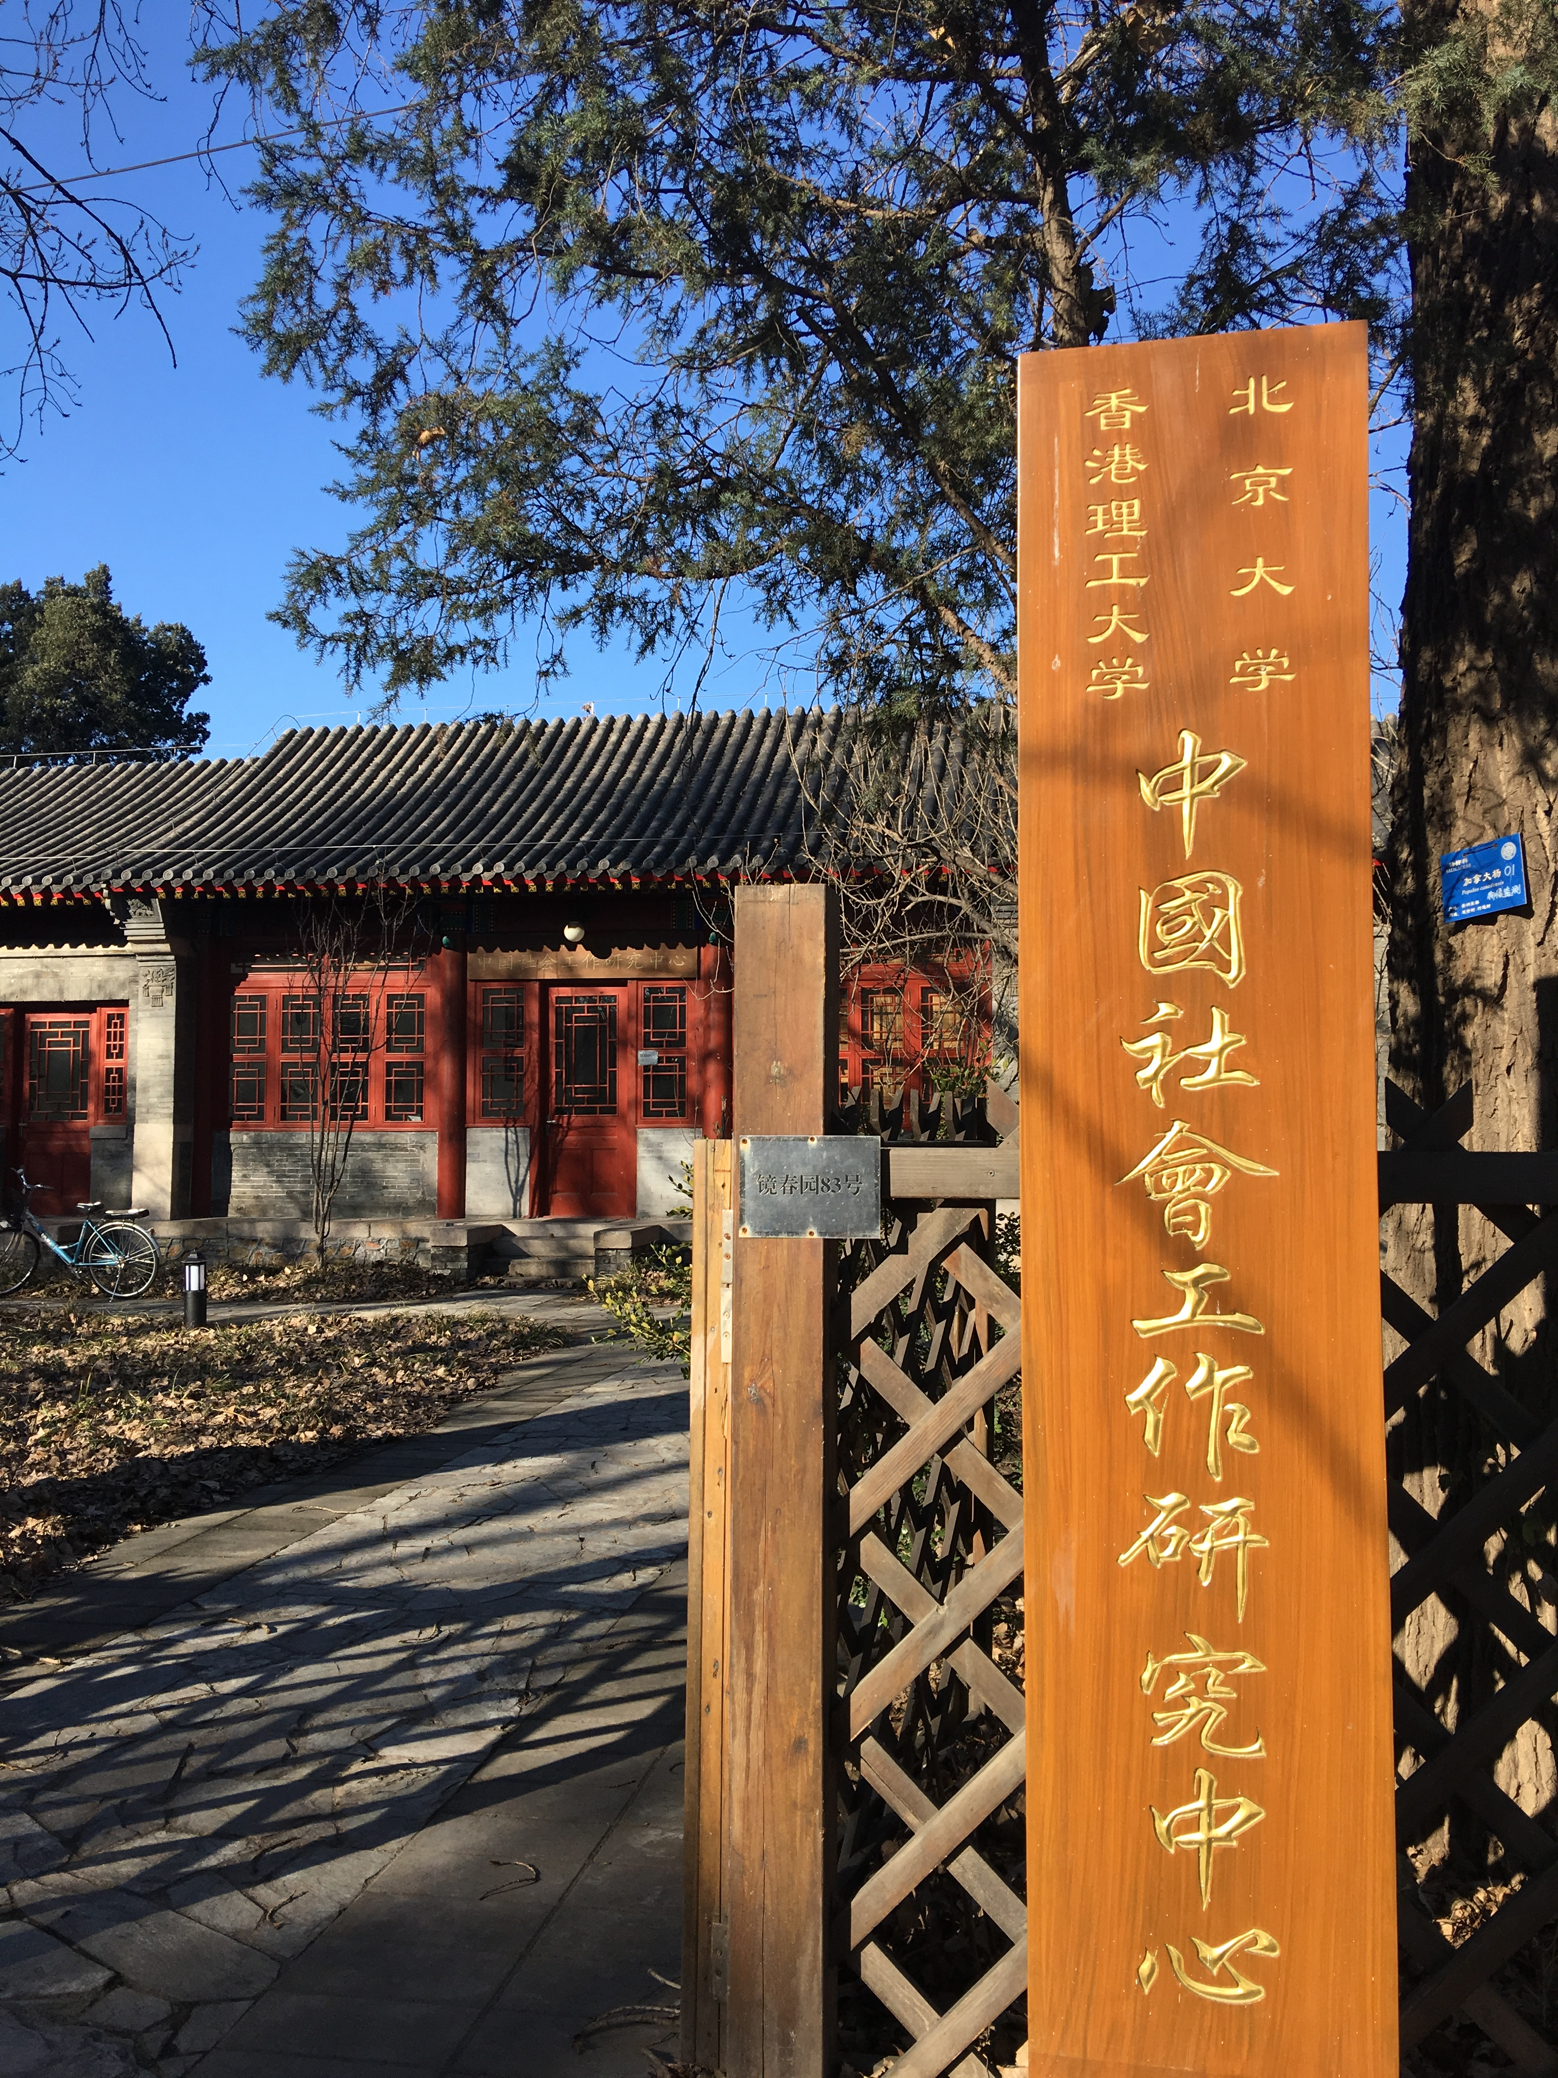
Networking mainland China and the World
Developing context-specific social work theories and practice by adopting participatory social work practice research in order to make positive changes through collaborative inquiry with local partners
Promoting social work value via providing education and research training to social work educators and practice in mainland China and other parts of the world
Developing collaborative partnership with universities in mainland China and the world, e.g. Peking U- Hong Kong PolyU China Social Work Research Center

Slide 10
PolyU
Thailand
Israel
Chinese Mainland
Vietnam
Kazakhstan

Slide 11
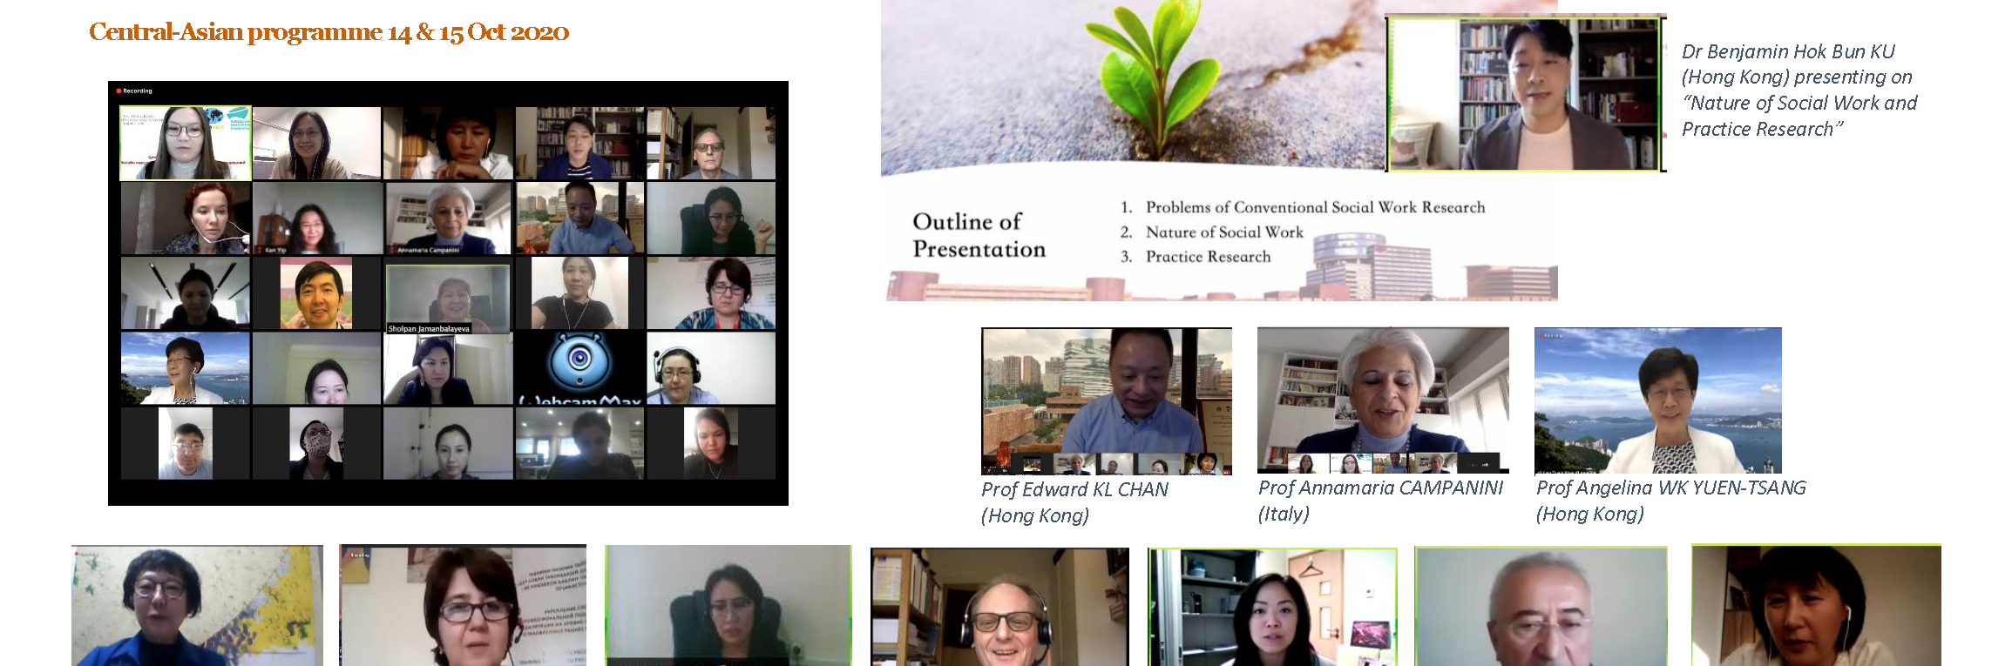
Example : 2020 Capacity building on social work education and research for Central Asia (partner with Al-Farabi Kazakh National University)

Slide 12
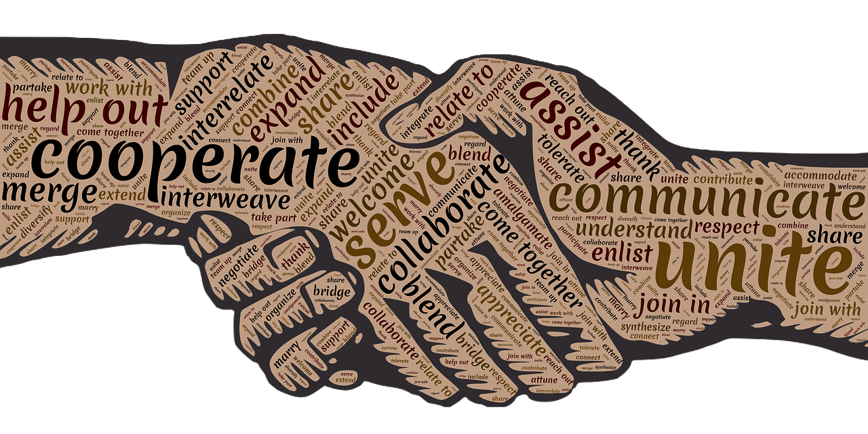
Envisioning an inclusive cross-border partnership through social work initiatives
Sustainable social development (SDG) as framework for social work practice
Action learning and mutual capacity building in collaboration
Co-creation of social work knowledge in responding to the context-specific needs
Building an inclusive world with social, cultural & religious diversity

Slide 13
Impact of Science
23-25 June, 2021
Catherine Odora Hoppers
Professor Extraordinarius in Education, Univeristy of South Africa, Uganda
#IOS21

Slide 14


THE IMPACT OF SCIENCE
Cape Town: 23rd – 25th June 2021
Sustainable Cross-Border Cooperation
THE ETHICAL IMPERATIVES IN THE DIALOGUE BETWEEN SCIENCE AND
OTHER KNOWDGE SYSTEMS
Session keynote
Catherine A. Odora Hoppers
Professor Extraordinarius, University of South Africa
Professor of Education, Gulu University, Uganda

Slide 15
The Other, Community and Society
As a people we know that no community is complete without the other.
No society is complete in itself
The other opens us, enlarges us;
Without the otherness of the other, the self is incomplete and even vulnerable

Slide 16
Knowledge and Society
What is true of society is true of knowledge
No knowledge is complete in itself
No knowledge is complete without the dreams of the other
Hospitality, reciprocity, generosity, plurality—
Without these, no “commons” of knowledge is possible (Visvanathan 2016).

Slide 17
Turning around us,
We all know that the prevailing
and dominating worldviews
that surrounds us today;
And which we are all compelled to respond to is one that is:

Slide 18
Narrow in its vision
Exclusive and detached in relating to the total environment
Analytical and deductive it its perception and thinking
Linear in its ‘doing’
Hierarchical and competitive it its management of the field of activity.

Slide 19
The painful facts
The era of the Empire, weak and strong at the same time,
declared Africa to have nothing.
Its knowledge systems were irrelevant.
We were unsuited for the ‘modern’ world (Ralston Saul 2014).

Slide 20
What has been the reaction?
First UNESCO Global Conference on Science and Society and the International Council of Science (Budapest 2000)
Par. 35 states that
“Modern science does not constitute the only form of knowledge,
and closer links need to be established between this and other forms, systems and approaches to knowledge,
for their mutual enrichment and benefit”.

Slide 21
It continues
A constructive inter-cultural debate is in order,
to help find ways of better linking modern science
to the broader knowledge heritage of humankind”
And further that:
“Countries should promote better understanding and use
of traditional knowledge systems,
instead of focusing only on extracting elements
for their perceived utility to the S&T system”

Slide 22
Taking a step back
Looking at the practice of science itself
For Archer (the former president of ICSU), science is caught on the supply side only (all theories, hypotheses have been provided)
all African scientists do is 'deliver" exactly as they are told.
This is ok.
But consider the demand side of science
where there is still curiousity, amazement, wonder, beauty
and most of all, critique of the uses of science on society.
It would be an exciting world to live in.

Slide 23
Unfortunately the current science we see is funded and some instances,
owned by multinationals
and there is little reason at all,
to consider other perspectives on science,
leave alone epistemological impacts of science on other cultures.
It is a long way from considering the political economy of science itself.

Slide 24
What do we need to do?
We need to create philosophers of science in Africa
that can deal with the metaphysics of different cultures
and constitutive rules (not the regulatory rules)
of every discipline
including science
in order to help scientists spot where the field
missed the bus!

Slide 25
Analytically,
Science is a fractured pilgrimage that turned the ‘self’ into a spectator, a recorder of events, an act of alienation.
Over time, the gaze of science over the so-called “non-scientific” became a gaze of surveillance.
The way science is constituted prevents the entry of pain and compassion, leaving the “I” of science an impoverished self without a backstage.
Drawing from numerous illustrations of disasters such as the Bhopal in India, the Holocaust in Europe, we lament at how scientists rarely pause to weep at the effects of their creation.

Slide 26
Indigenous Knowledge Systems forces science to become a part of a struggle of memory against forgetting.
The bringing of Indigenous Knowledge Systems into the formal
is what will enable the contesting of the museumization of the “Other”,
and exposes the insensitivity of science,
which meets the “Other” only in death.

Slide 27
Visvanathan argues that science is, in fact,
not only political,
but goes beyond politics
to create its own micro-physics of power,
with its own capillaries by pre-empting
and terminally judging
the way one thinks.

Slide 28
Science as a rule game must be challenged
or reworked
and thus epistemology,
i.e. rules or methods for the making of knowledge becomes crucial.
In fact, the “scientific method" as an ideology has become a Victorian corset constricting creativity.

Slide 29
Therefore it is not restraint that science needs
but a celebration of plurality,
which is the only antidote to the ethnocentrism
so deeply embedded in its ethos.
Science must recover its sense of questioning and dwelling,
and begin to produce a medicine for its melancholy
and recover its sense of play.

Slide 30
Cognitive justice
We need the rights of different traditions
and forms of knowledge to exist for science to survive.
When you standardize the mind,
you destroy the fecundity of citizenship.
In other words, the citizen does not need to be posited
as a layman before scientists.

Slide 31
Every man is a scientist,
and every village is a science academy.
Citizens must have institutionalised access to institutions,
and be allowed to propose technological scenarios.
Science must become AN AGENT OF PLURALITY.

Slide 32
Taking a historical perspective, ethical insensitivity in science towards other forms of knowing is most profound.
The problem of ethical insensitivity is that
it was always thought of as the problem of balance between techno-science and culture science.
Well, the imbalance has a deeper source.
It was a sickness of the mind, in Plato’s time,
and it is the same sickness of the mind, in our time.
When it comes to thinking, epistemic thinking, thinking about thinking,
the sickness is inherent in rationality, in the dominance of the rational mind.

Slide 33
Nobel Prize winner Elie Wiesel in a speech to the Global Forum, Moscow in 1990,
stated that the designers and perpetrators of the Holocaust, were the heirs of Kant and Goethe.
In most respects the Germans were the best educated people on Earth, he said,
but their education did not serve as an adequate barrier to barbarity. What was wrong with their education?
In Wiesel's words: "It emphasized theories instead of values,
concepts rather than human beings,
abstraction rather than consciousness,
answers instead of questions,
ideology and efficiency rather than conscience" (Wiesel 1990).

Slide 34
Rotblat stated that when the Royal Society - which is now the National Academy of Sciences in the UK –
was formed 340+ years ago, one of its founders , the famous physicists Robert Hooke stipulated that the society
“should not meddle in Divinity, Moralls, Metaphysicks, Politics, Grammar, Rhetorick or Logick”.
This rather odd assortment of “banned topics” does not figure in the Charter of the Royal Society now,
BUT THE SPIRIT OF EXCLUSIVITY IS STILL THERE” (Rotblat 2000:45).

Slide 35
This detachment from general human affairs
led them to build an ivory tower in which the scientists sheltered…
pretending that their work had nothing to do with human welfare.
The aim of scientific research – they asserted – was to understand the laws of “nature”;
since these are immutable and unaffected human reactions and emotions,
these reactions and emotions had no place in the study of “nature” (Rotblat 2000:45).

Slide 36
Scientist then evolved certain precepts about science to justify the separation from reality.
These were:
“science for its own sake”
“scientific inquiry knows no limits”
“science is rational and objective”
“science is neutral”
“science has nothing to do with politics”
“scientists are just technical workers”
“science cannot be blamed for its misapplication”

Slide 37
Ziman (1982) analysed each of this and found them all wanting in the current context.
It is not only that most scientists are employed by manufacturing companies
whose chief aim was to discover drugs that make profit;
they have also been at the heart of most discoveries that destroy life and create misery.

Slide 38
Ethical questions about the consequences of this applied research were not asked by their employers,
and their “employees were discouraged from concerning themselves with these issues” (Rotblat 2000:45)
as the grandfather Robert Hookes had said 340 years ago.

Slide 39
He said in Keynote in the Unesco Conference on Science and Society in Budapest (2000) that the scientists can no longer claim
that their work has nothing to do with the welfare of the individual or with state politics.
The more scientists understand that knowledge brings responsibility, the better.
In short, scientists must show by their conduct that it is possible to combine creativeness with compassion:
letting the imagination roam with caring for fellow creatures, venturing into the unknown yet fully accountable for one’s doing.
The basic human value is life itself; and the most important of human rights is the right to live (Rotblat 2000).

Slide 40
In conclusion, just imagine what the former Director General of UNESCO, Koichiro Matsuura said…
Can we today imagine any use of biotechnologies that disregards the cultural conditions of how they are applied?
Or a science heedless of scientific education or local knowledge?
Or a culture neglectful of education transmission
and new forms of knowledge? (Matsuura K, 2005).
THANKYOU

Slide 41
Impact of Science
23-25 June, 2021
Sioux McKenna
Professor & Director of the Centre for Postgraduate Studies at Rhodes University, South Africa
#IOS21

Slide 42



Sustainable
Cross-Border Cooperation
Sioux McKenna
Centre for Postgraduate Studies, Rhodes University, South Africa

Slide 43
Three projects
NUFFIC funded and EU Erasmus+ funded
Collaborations between Dutch and South African universities, and later Kenyan, Turkish and Belgian
Focused on enhancing postgraduate education
Staff development courses and educational videos
https://postgradenvironments.com/

Slide 44
Developing a shared ideology
Understand postgraduate education as a public good and a social justice issue
But…
Enormous differences in institutional contexts
Enormous differences in understandings of role of the university, research and postgraduate education

Slide 45
The benefits
Transformative nature of science
Impact of science

Slide 46
The challenges
Hierarchies of knowledge
Absenting of experience
Requirements of funders
Assumptions of funders

Slide 47
The solution
Consensus about project prior and during
Reflection on power
Understandings of history
Kindness

Slide 48
Thank you
Sioux McKenna
Centre for Postgraduate Studies, Rhodes University, South Africa

Slide 49
Impact of Science
23-25 June, 2021
Thank you
#IOS21

